Slide 1
ARTIFICIAL INTELLIGENCE
AI IN EDUCATION
(CV PARSER)
EDUCATION OF PRESENTATION

Slide 2


Slide 3
EDUCATION OF PRESENTATION
Every time you meet someone, the impression of you on that person is decided by how well you Present Yourself.
So if you know who likes what kind of behaviour, then it will be pretty easy to impress them.
That’s why the Knowledge of how to present yourself is really important.
And Educating people about it will be really useful,

Slide 4
But why waste time and energy if machines can do it for us?

Slide 5
CV PERSONALITY PREDICTION
When you are in college then the main aim of many is to find a perfect job.
And for getting a job they have to sit in the placements.
And the first contact between a company and a student is through their Resume.
Once the Resume gets shortlisted then only the student get the chance to sit for further drives.
So, If you get to know if your CV personality is matching with the job profile or not, then it will be convenient for you during interview.

Slide 6
Personality Traits
Openness: sometimes called "Intellect" or "Imagination," this measures your level of creativity, and your desire for knowledge and new experiences.
Conscientiousness: this looks at the level of care that you take in your life and work. If you score highly in conscientiousness, you'll likely be organized and thorough, and know how to make plans and follow them through. If you score low, you'll likely be lax and disorganized.
Extraversion/Introversion: this dimension measures your level of sociability. Are you outgoing or quiet, for instance? Do you draw energy from a crowd, or do you find it difficult to work and communicate with other people?
Agreeableness: this dimension measures how well you get on with other people. Are you considerate, helpful and willing to compromise? Or do you tend to put your needs before others’?
Natural Reactions: sometimes called "Emotional Stability" or "Neuroticism," this measure emotional reactions. Do you react negatively or calmly to bad news? Do you worry obsessively about small details, or are you relaxed in stressful situations

Slide 7
OUR OBJECTIVE
In our daily life, we encourage our formal education but even after getting good results in our schools and colleges many of us suffer to get success in life, the main cause of this problem that we encountered is a lack of “Education of presentation”, here we are solving this problem by analyzing the cv’s of students and helping them improve their presentation of skills.

Slide 8
OUR APPROACH
The system built in this project predicts personality of peoples by using their gender, age, score of openness, conscientiousness, extraversion, agreeableness, neuroticism and experience. It parses all the data from CV/resume and on the result page, it shows all the information from the entered data and uploaded resume. This system uses logistic regression for training the model and pyresparser module for parsing the information from resume which is built using nltk and spaCy module in python.

Slide 9
LIBRARIES WE USED (PYTHON)
OS: For accessing the files and data from internal storage.
Pandas: For accessing and manipulating datasheets.
Numpy: For working on arrays and other data manipulation.
Tkinter: For building the GUI.
Functools: Tools for Manipulating Functions. Purpose: Functions that operate on other functions.
Pyresparser: Module for extracting information from resume.
Sklearn: It features various classification, regression and clustering algorithms. We used sklearn to make the model learn on various characteristic values using logical regression.

Slide 10
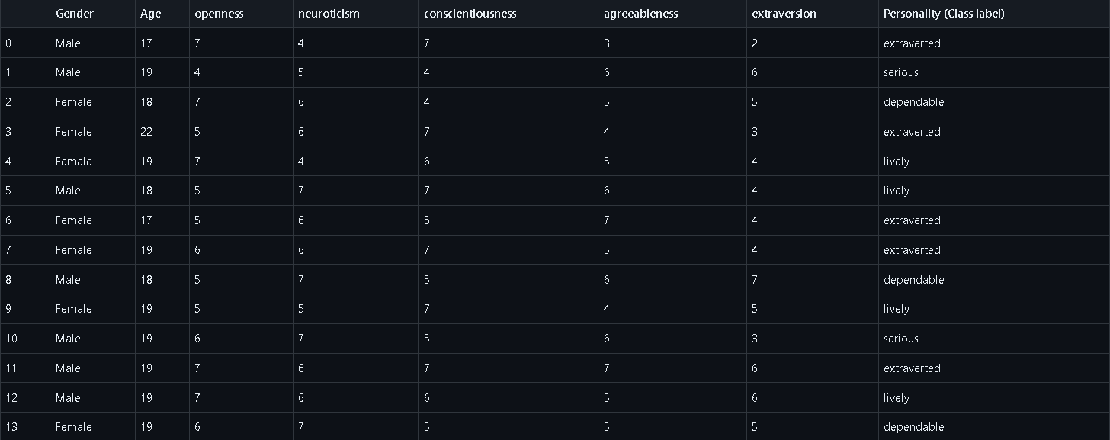

Slide 11
RESULTS

Slide 12
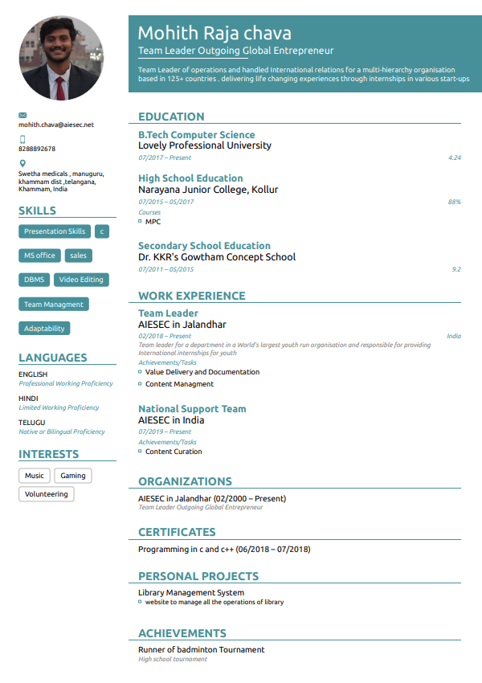

Slide 13
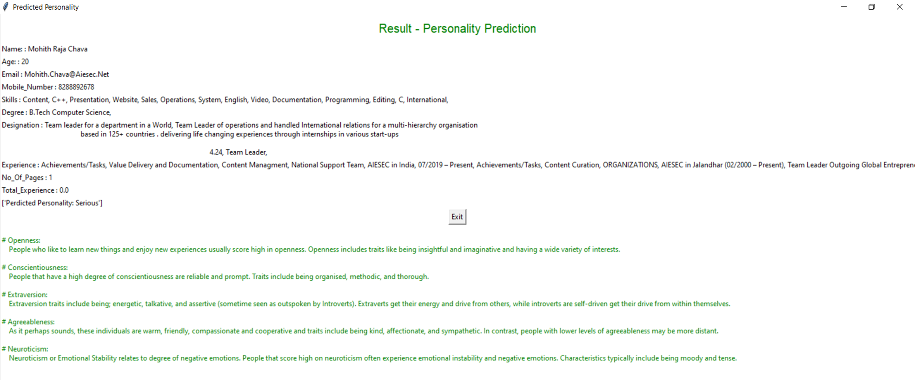

Slide 14
SARAL SAINI (59) SAQUIB (11) PRITAM(35)

